Slide 1
Modern Compiler Design and Virtual Machine Architectures
Presented by: Randy Hollines

Slide 2
Purpose
Why should I care?
Software engineers leverage computer languages on a daily basis to create solutions
Knowing how compilers work means knowing how computers work
Languages and their supporting platforms impose a variety constraints on programmers
It’s a remerging subject area

Slide 3
Agenda
Brief history of computer languages
General survey of modern computer languages
Introduction to computer language design
Compiler Design
Virtual Machine Architectures
Hands on Demonstration of Key Concepts

Slide 4
Computer Language History
Prior to Fortran
Difference and analytic engines
AUTOCODE an early algebraic compiler circ. 1952
Fortran
Developed in 1955 by John Backus at IBM
Target system IBM 704
Credited as being the 1st high-level language

Slide 5
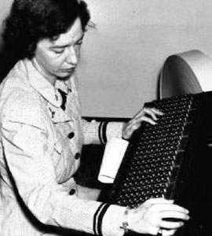
Computer Language History
Cobol (Common Business-Oriented Language)
Developed in 1959
Created by Grace Hopper
Designed for business and financial use
Features
English like syntax
Global variables
Static memory allocation

Slide 6

Computer Language History
The Basic Language
Developed in 1964
Created by Kemeny and Kurtz at Dartmouth College
Designed for general use on timesharing systems
Features
Interactive
Simple language syntax
Shielded user from hardware (OS like functionality)

Slide 7
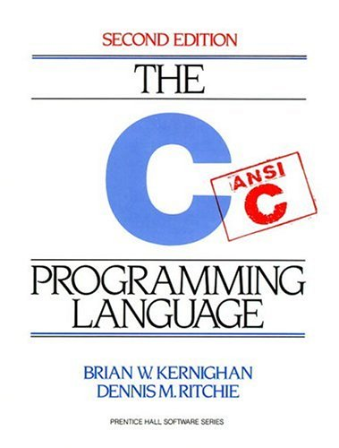
Computer Language History
The C Language
Developed in 1972
Created by Dennis Ritchie at AT&T
Designed for UNIX system programming
Intended to be machine-independent
Features
Supports structured programming
Pseudo-weakly typed
Lack of array bounds checking

Slide 8
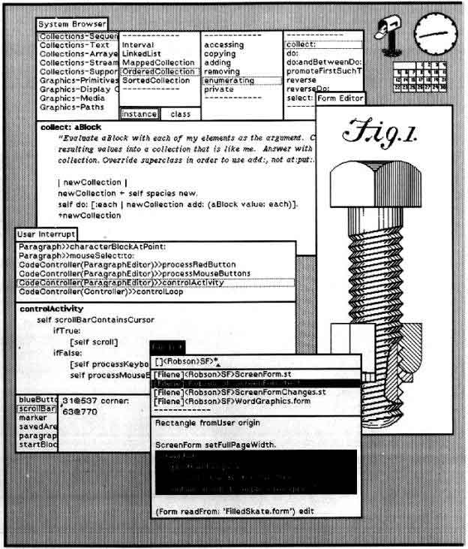
Computer Language History
Smalltalk
Developed in 1973
Created by Alan Kay at Xerox Parc
Designed for business and financial use
Used to develop the Xerox Alto windowing system
Features
Object-oriented
Integrated development environment
Support for message passing

Slide 9
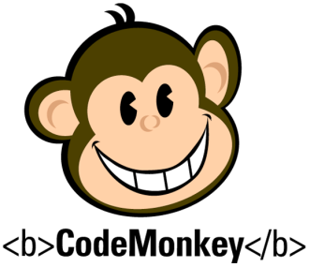
Current Trends
Most Popular Programming Languages (Dice.com, 10/06)
Java – 35.7%
C,C++ – 15.3%
C# – 12.7%
Perl – 11.9%
JavaScript – 10.9%
Visual Basic .NET – 5.2%
PHP – 2.9%
Ajax – 2.7%
Python – 2.0%
Ruby – 0.7%

Slide 10
Modern Languages Trends
Scripting Languages
Domain Specific
Web: JavaScript, VBScript, PHP, ActionScript, etc.
Text processing: SED, Snowball, etc.
General Purpose
Perl
Python
Ruby
Most scripting languages are interpreted (but may be compiled)
Highly flexible
Platform independent
Weakly typed
Slower execution speed

Slide 11
Modern Languages Trends
Functional Languages
print length([2+1, 3*2, 1/0, 5-4])
Based on lambda calculus
Avoids the sides effects of traditional function calls
Does not modify calculated values
Strict vs. Non-strict evaluation
Heavy use of recursion
Popular languages include
Lisp
F#
OCaml
Not widely used in commercial development

Slide 12
Modern Languages Trends
Object-Oriented Languages
First credited OO language was Simula (created in 1967)
Originally designed to model the “real world”
In “pure” OO languages everything is an object
Smalltalk, Ruby, etc.
General features of an OO language are: classes, methods, inheritance and reusability
Compiled and interrupted

Slide 13
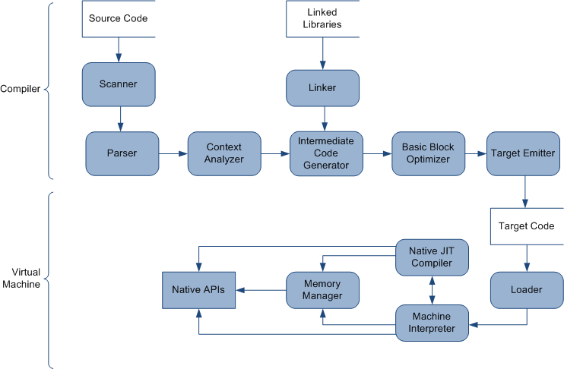
Compiler Design
Notes:
Add context highlights for key areas in this diagram

Slide 14
Compiler Design
Language Grammars
Languages are recursive by nature
Different techniques for parsing languages
BNF Grammar Notation
<statement> ::= <expression> “;”
<statement> ::= <math_term> | <logic_term>
<math_term> ::= <factor> | <factor> “+” <math_term> | <factor> “-” <math_term>
<factor> ::= <number> | < number > “*” <factor> | <number> “/” <factor>

Slide 15
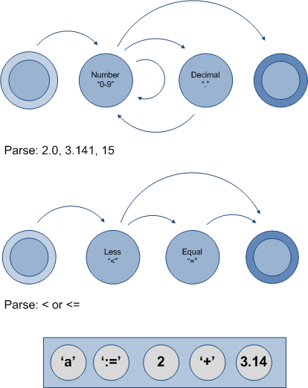
Compiler Design
Token Scanning
Translating text to tokens
Tokens are the smallest meaningful unit of a program
Most languages ignore leading whitespace
Token can be described via regular expressions
Scanners can be automatically generated or handwritten

Slide 16
Compiler Design
Parsing
From token to tree nodes
A program is made up of a list of parse trees
Statements act as tree roots
Simple expressions are non-terminals
Values are terminals
Scope can be established during parsing
Parsers may be generated or handwritten

Slide 17
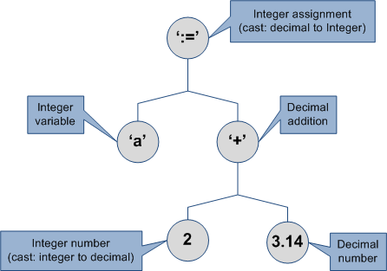
Compiler Design
Semantic Analysis
Determines the meaning and correctness of a program
May evoke runtime simulations to derive meaning
Parse trees are decorates with semantic information
Some checks can only be preformed at runtime
Normally manually written

Slide 18
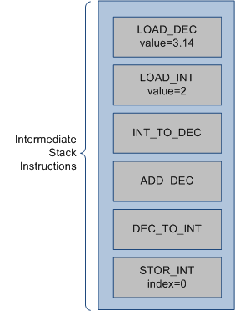
Compiler Design
Intermediate Code
Runtime representation of a program
Used for machine independent optimizations
Generated by walking augmented parse trees
May be the target format or used to generate the target format (i.e. assembly code)

Slide 19
Compiler Design
Optimizations
Local Optimizations
Constant folding
Constant propagation
Strength reduction
Common sub expression elimination
Loop inversion
Global Optimizations
Benefit vs. cost
Notes:
Look at optimization book (1996)

Slide 20
Virtual Machine Architecture

Slide 21
Virtual Machine Architecture
What is a Virtual Machine?
Provides an abstraction between the runtime system and physical hardware
May provide operating system and/or processor independence
Virtual machine models generally differ from processor models
Code generation for VMs is simpler
Popular Platforms
.NET, Java, ActionScript, etc.
Notes:
Why virtual machines?

Slide 22
Virtual Machine Architecture
Language Interpreters
Target machine code execution is simulated (i.e. fetch, decode and execute)
Interpreted instruction sets normally differs from native instructions
Provides more flexibility for weakly typed languages (i.e. VB)
Increased portability
Cons
Slow execution speeds
40% of processing time for stack based interpreters is stack management (push/pop)

Slide 23
Virtual Machine Architecture
Just-In-Time Compilers
Compile byte code to machine code at runtime
Increases execution speed for frequently executed methods/functions
Code flows between interpreter and native machine code
Challenges
Translating between different computing models
Fast register allocation
Traditional register allocation is NP complete

Slide 24
Virtual Machine Architecture
Memory Management
Manual Memory Management
“Automatic” Memory Management
Reference Counting
Tracks the number of references to an object instance
Recursion may create circular references
Tracing Algorithms
Mark and Sweep
Stop and Copy
Generational

Slide 25
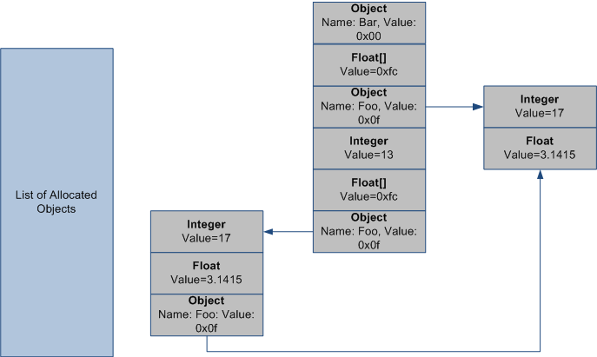
Virtual Machine Architecture
Mark-and-Sweep
Identify Roots
Values that exist on the execution stack, interpreted and native stack frames
Need to tag segments of memory
Mark
Trace roots; object and arrays
Mark the memory segments encountered
Stop if a given path has already been explored
Sweep
Memory not reachable via roots is garbage
Collect and reclaim garbage

Slide 26
Sources and References
History
Go To: The Programmers Who Created the Software Revolution (Lohr)
Academic
Compilers: Principles, Techniques, and Tools (Aho, Lam, Sethi and Ullman)
Modern Compiler Design (Grune, Jacobs, Langendoen)
Engineering a Compiler (Torczon)
Advanced
Programming Language Pragmatics, 3rd Edition (Scott)
Advanced Compiler Design and Implementation (Muchnick)

Slide 27
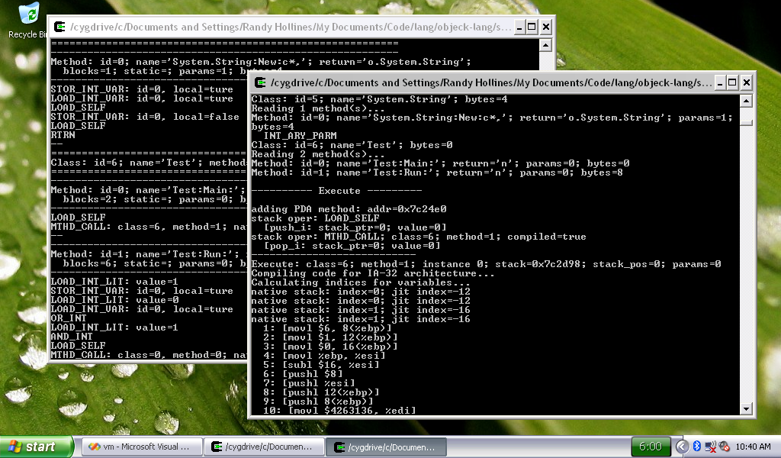
Compiler VM Demonstration

Slide 28

Compiler VM Demonstration
Project Goals
“Objeck” computer language
General object-oriented language
Syntax similar to Ruby and Java
Written in C++
Language Architecture
Source code is compiled to decorated bytecode
Incorporates machine independent optimizations
Bytecode may be compiled to x86 machine at runtime
Mark and sweep memory management

